Slide 1
Agile Presentation
Matthew Keaton
CS250

Slide 2
Overview
What is Agile?
Agile is a project management methodology that emphasizes iterative development, collaboration, and flexibility
What is Waterfall?
Waterfall is a linear project management methodology where each phase follows sequentially, with each phase completed before the next begins.
Notes:
Today I would like to talk about two popular methodologies in the software development lifecycle, agile and waterfall. Agile is a flexible approach where teams work on small parts of a project and make changes as needed based on regular feedback. It's great for projects where things might change often. On the other hand, Waterfall is a step-by-step approach where you finish each phase, like planning and building, before moving to the next one. It works well when you have a clear idea of what you want from the start and don’t expect things to change much

Slide 3
Scrum-Agile Team Roles
Product Owner - The Product Owner is accountable for maximizing the value of the product resulting from the work of the Scrum Team
Scrum Master - The Scrum Master is accountable for establishing Scrum as defined in the Scrum Guide
Developer - Developers are the people in the Scrum Team that are committed to creating any aspect of a usable Increment each Sprint
Testers – The testers check the product to make sure it works properly and report any issues
Notes:
Now let's focus on the scrum-agile method and the scrum-agile roles that are typically on the scrum team. the Product Owner decides what the team should work on next and makes sure that the team is building the most important features first. The Scrum Master helps the team follow the Scrum process by organizing meetings, solving problems, and making sure everyone is working well together. The Development Team actually builds the product, doing everything from writing code to fixing bugs. Testers check the product to make sure it works properly and report any issues so they can be fixed before the product is released. All these roles work together to make sure the project stays on track and meets the needs of users.

Slide 4
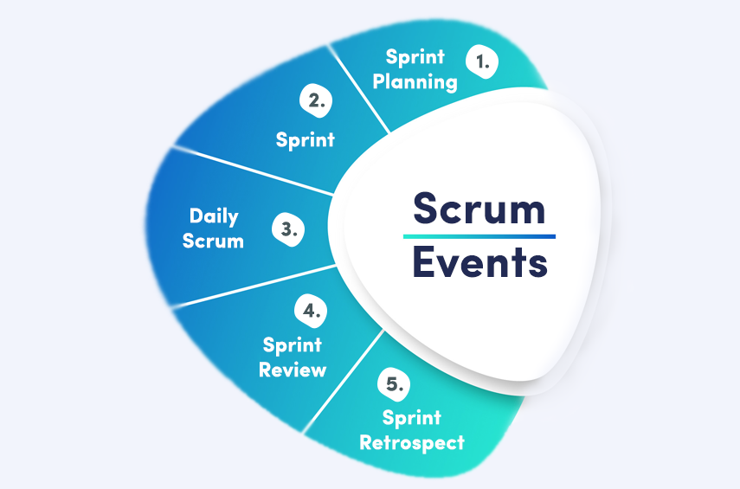
Agile Phases
Notes:
In Agile, the project is divided into several phases called Sprints, each typically lasting 1 to 4 weeks. The process starts with Sprint Planning, where the team decides what work to complete in the upcoming Sprint based on the product backlog. During the Sprint, the team works collaboratively to develop and deliver small, functional increments of the product. Daily scrums are team meetings held daily for approximately 30 minutes to inspect progress towards the sprint goal. At the end of each Sprint, the team holds a Sprint Review to demonstrate what has been completed and gather feedback. Finally, the team conducts a Sprint Retrospective to reflect on the Sprint, discuss what went well, and identify areas for improvement. This cycle repeats, allowing for continuous improvement and adaptation throughout the project.

Slide 5
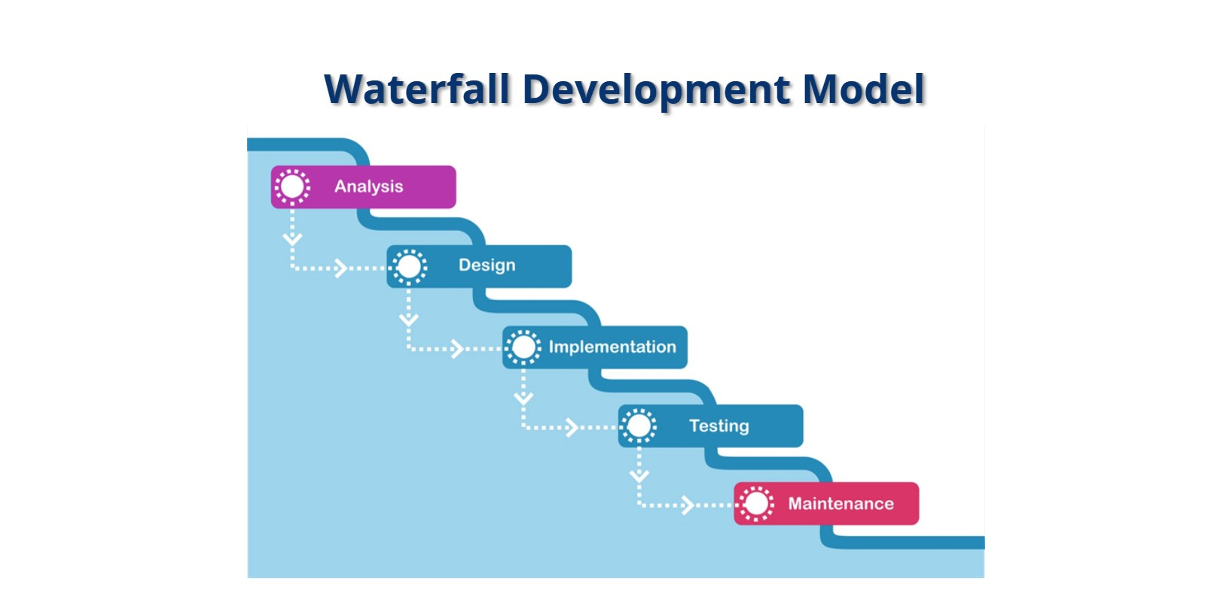
Notes:
As you can see the waterfall development models follows a direct path. In other words, if you find a problem or need a change after starting development, it can be hard and expensive to fix because you have to go back and change things from earlier stages. Everything happens in a strict order, so you can't easily make changes once you move on. In Agile, problems are tackled right away during each short development cycle, making it easier to adjust and fix things as you go along, without major delays or extra costs. For example, during the SNHU Travel project the SNHU Travel team decided to make a change later in the process towards the testing phase. If we took a waterfall approach, we would have to begin back at the analysis phases taking much longer and needing more time to complete the product.

Slide 6
Agile or Waterfall?
Agile
Waterfall
Pros | Cons | Pros | Cons
Adaptability | Learning curve | Clear structure | Non-flexibility
Continuous improvement | High engagement | Easy management | Late testing
Collaboration | Better for smaller teams | Sustainable for simple projects | Higher risk
Risk mitigation |  |  | Limited involvement
Tools
Notes:
Key factors to think about when deciding between Waterfall and Agile, is to think about the project’s needs. If everything is clear from the start and unlikely to change, Waterfall works well because it follows a strict plan. For example, in a project with fixed goals, Waterfall helps by keeping everything organized and on track. But if the project might change a lot or needs regular feedback, Agile is better. For the SNHU Travel project, taking an Agile approach is the best method to adjust for changes that were made.

Slide 7
References
Kumar Singh, N. (2016, August 1). What is Scrum? – principles, events, benefits, and Accountability. What is Scrum: Values, Roles, Events, Artifacts, and History. https://agilemania.com/what-is-scrum
Overeem, B. (2016, April 15). Characteristics of a great scrum team. InfoQ. https://www.infoq.com/articles/great-scrum-team/
Schwaber, K., & Sutherland, J. (2020, November). The Scrum Guide. Scrum.org. https://www.scrum.org/resources/scrum-guide
Scrum Events Model. (2024, August 17). Google Images [Image]. agile scrum events - Google Search
Waterfall Model. (2024, August 17). SNHU Module One: SDLC Methodologies[Image]. https://snhu media.snhu.edu/files/course_repository/undergraduate/cs/cs250/storyline/mod1/story_html .html

